Slide 1
Lecture 5: Collection Data Types (continued..)
Dipendra Thapa
Dipendra.Thapa@icp.edu.np
CS4051 Fundamentals of Computing

Slide 2
Agenda
Revision
Loops and Conditionals
Lists
Bubble sort – a simple sorting algorithm
Pseudocode

Slide 3
Control Flow – Branching/Conditionals
if <condition>:
<expression> # code that does something
<expression> # code that does something
else:
<expression> # code that does something
<expression> # code that does something

Slide 4
Control Flow – Branching/Conditionals
if <condition>:
<expression> # code that does something
<expression> # code that does something
elif <condition>:
<expression> # code that does something
<expression> # code that does something
else:
<expression> # code that does something
<expression> # code that does something

Slide 5
Control Flow: while loops
while <condition>:
<expression>
<expression>
...
<condition> evaluates to a Boolean
if <condition> is True, do all the steps inside the while code block
check <condition> again
repeat if <condition> is True, else stop

Slide 6
Control Flow: for loops
for <variable> in range(n):
<expression>
<expression>
...
each time through the loop, <variable> takes a value
first time, <variable> starts at the 0
next time, <variable> get the previous value +1
the value of <variable> goes from 0 to n-1
the range function generates a list of numbers from 0 to n-1

Slide 7
Odd or Even using while loop
i = 1 # set counter/start
n = 5 # end
while i <= n:
if i % 2 == 0:
print(i, "is even")
else:
print(i, "is odd")
i = i + 1 # increment counter
1 is odd
2 is even
3 is odd
4 is even
5 is odd

Slide 8
Odd or Even using for loop
n = 5
for i in range(1, n+1):
if i % 2 == 0:
print(i, "is even")
else:
print(i, "is odd")
1 is odd
2 is even
3 is odd
4 is even
5 is odd

Slide 9
Lists
ordered sequence of elements, accessible by index
list indices start at 0
a = [34,22,54,99,45] # a list of numbers
print(a[0]) # prints out 34
print(a[4]) # prints out 45
print(a[5]) # gives an error
0 1 2 3 4

Slide 10
Lists
lists support negative indexing too, starting at -1 from the end
a = [34,22,54,99,45] # a list of numbers
print(a[-1]) # prints out 45
print(a[-5]) # prints out 34
print(a[-6]) # gives an error
-5 -4 -3 -2 -1

Slide 11
Iterating over a list- using for loop
L = [2,43,21,5,46]
print(len(L)) # 5
for i in range(len(L)):
print(L[i]) # print the element at index i
range(len(L)) -> range(5) -> 0 to 4 which are the indices of the list
indices
0 | 1 | 2 | 3 | 4
2 | 43 | 21 | 5 | 46
elements

Slide 12
Iterating over a list – for each loop
note that each is just a variable here, any other variable name can be used
a more simpler way using for each loop
for <element> in <list>:
<expression>
...
L = [2,43,21,5,46]
for each in L:
print(each)
>>>
2
43
21
5
46

Slide 13
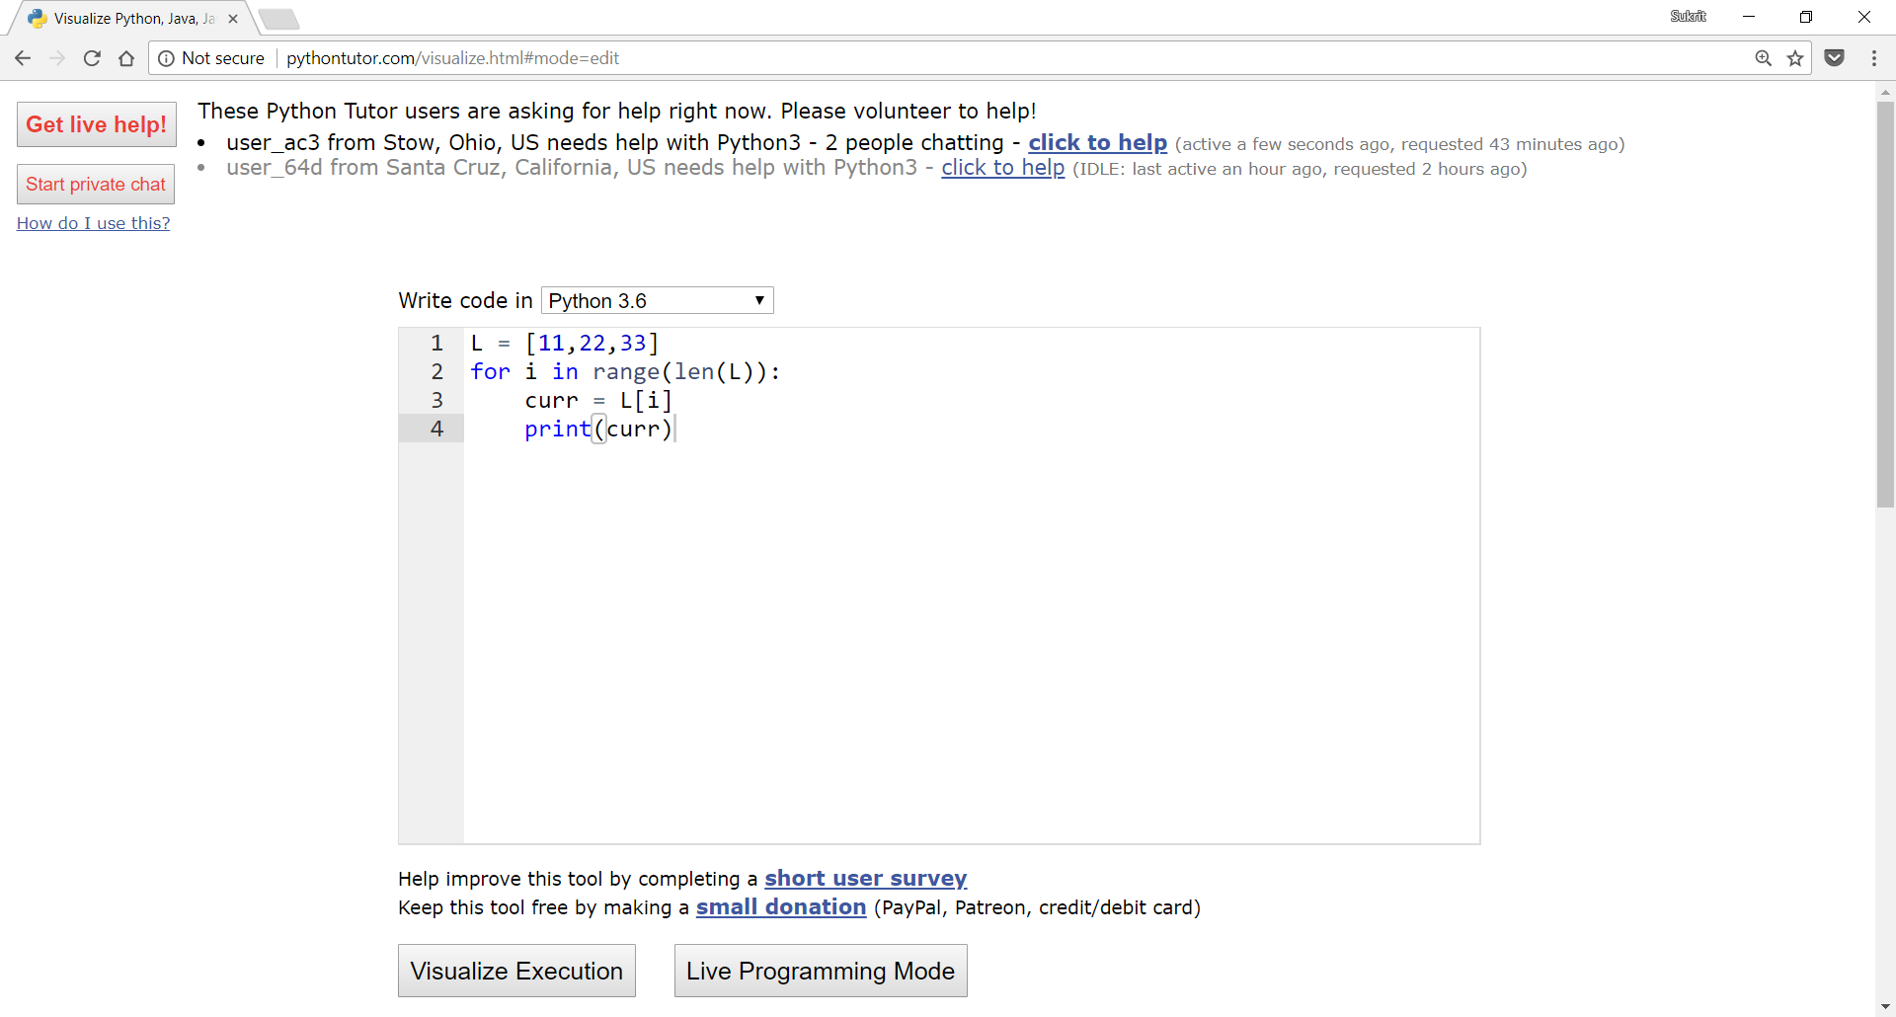
Visualize how your program is working
Python Tutor is your best friend to do this www.pythontutor.com

Slide 14
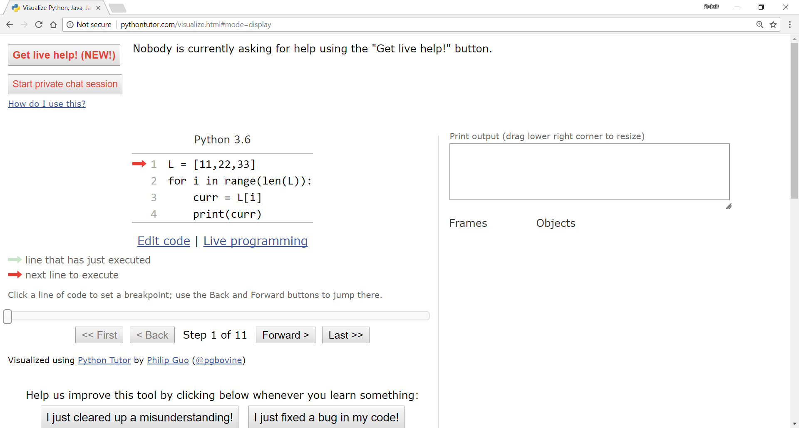
Visualizing iteration through lists

Slide 15
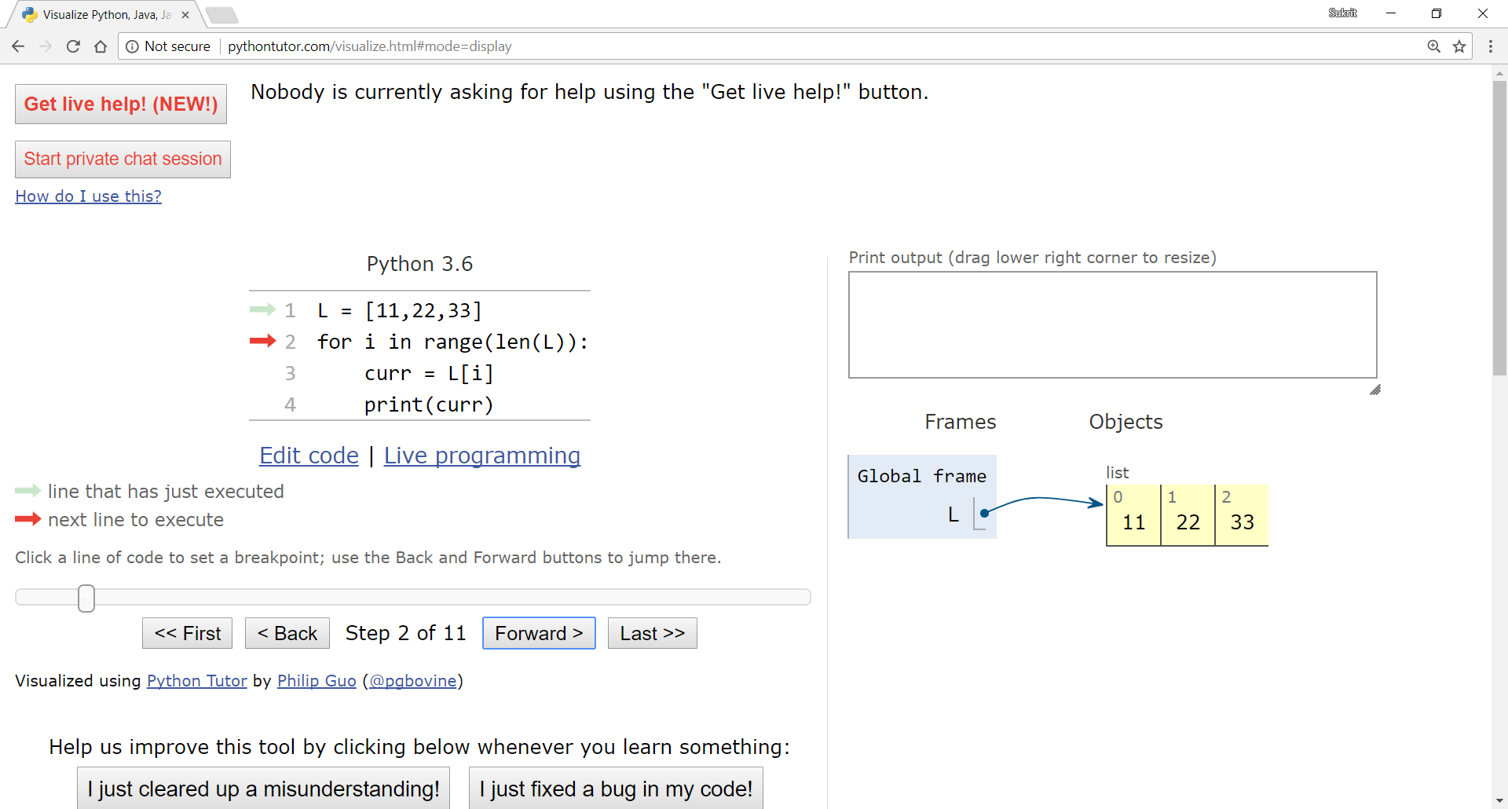
Visualizing iteration through lists

Slide 16
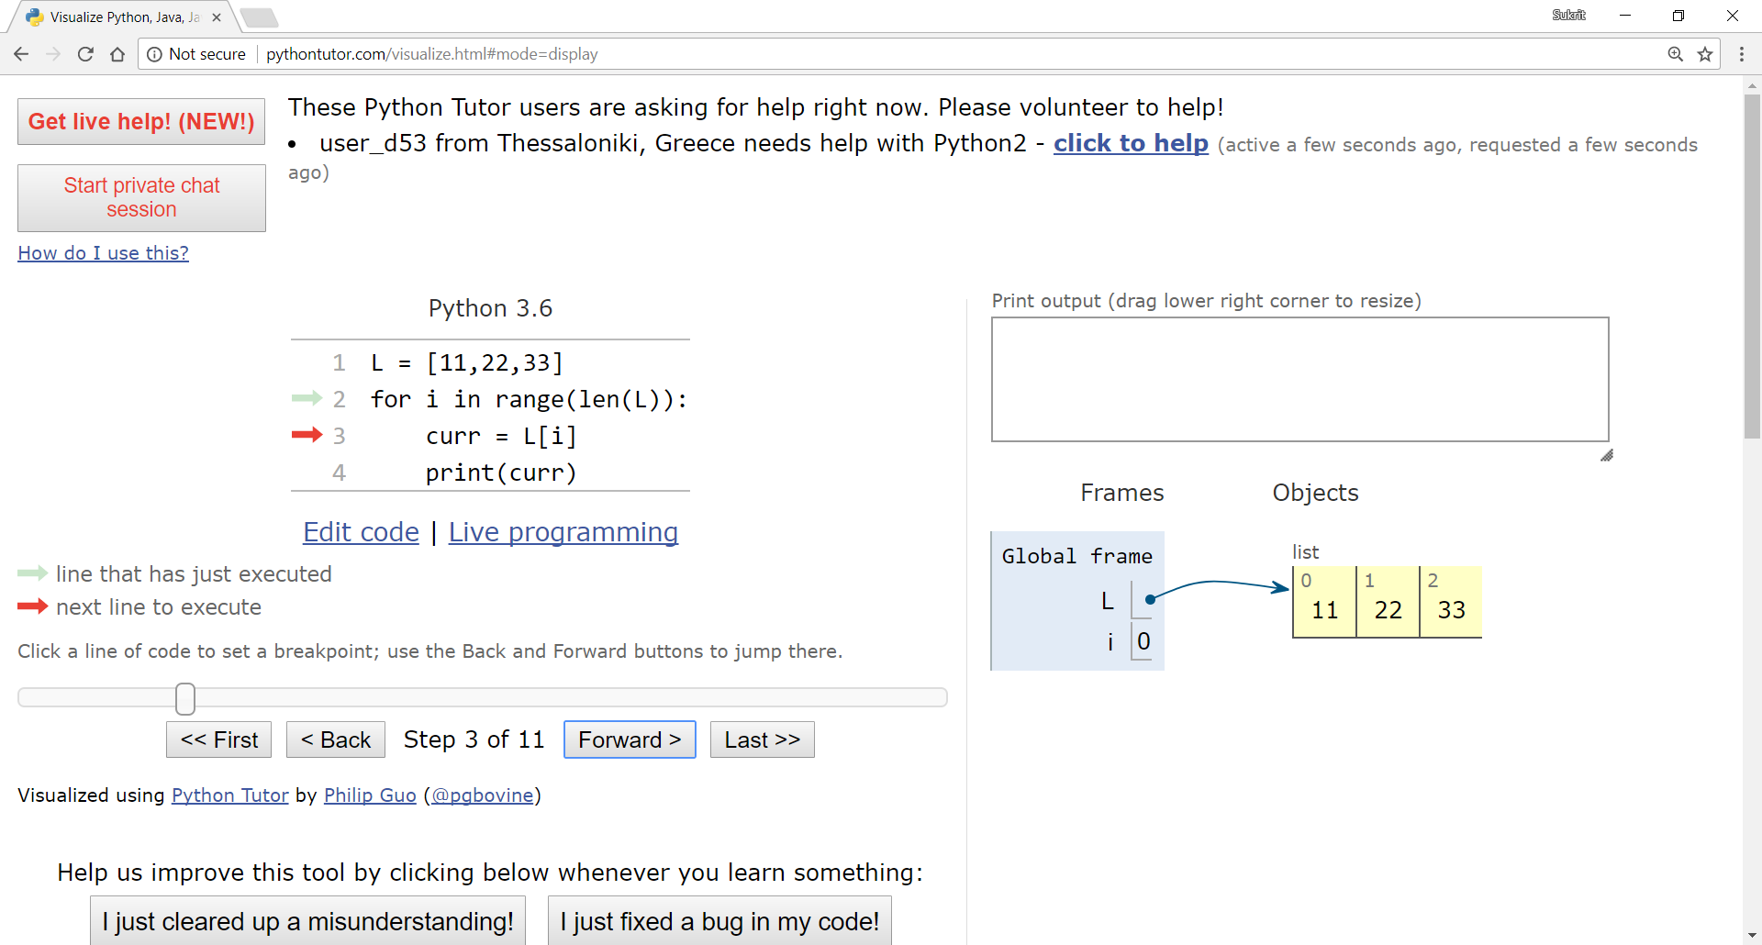
Visualizing iteration through lists

Slide 17
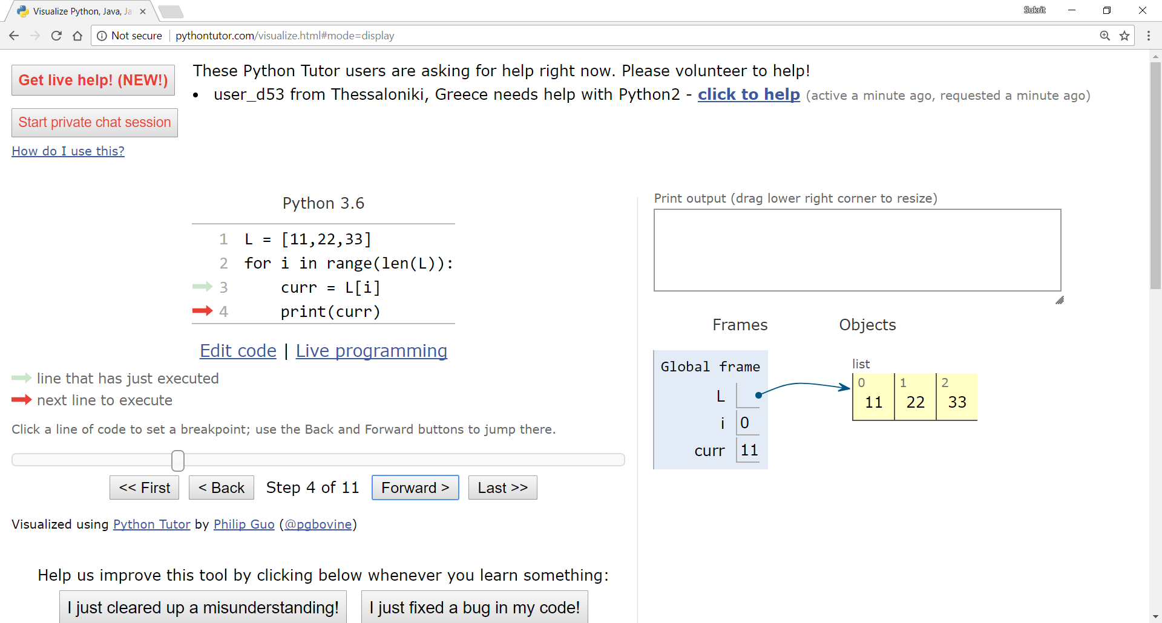
Visualizing iteration through lists

Slide 18
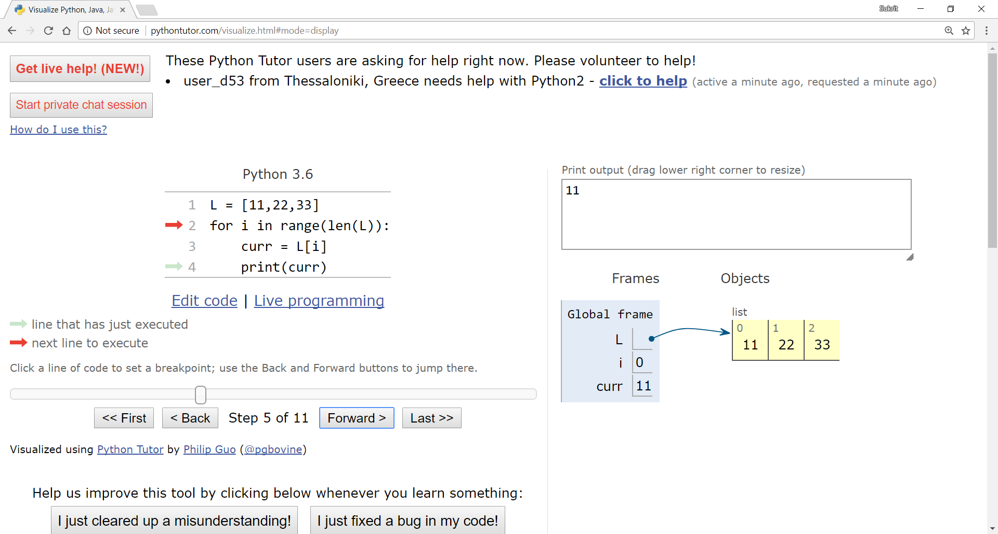
Visualizing iteration through lists

Slide 19

Visualizing iteration through lists

Slide 20

Visualizing iteration through lists

Slide 21
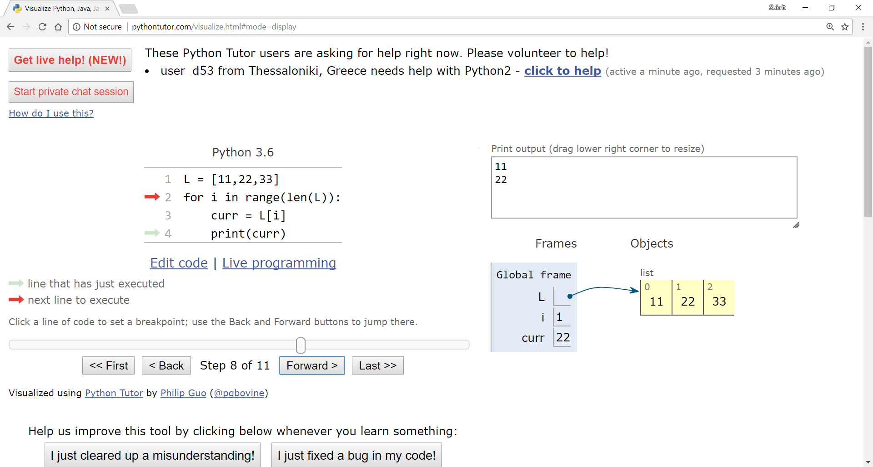
Visualizing iteration through lists

Slide 22
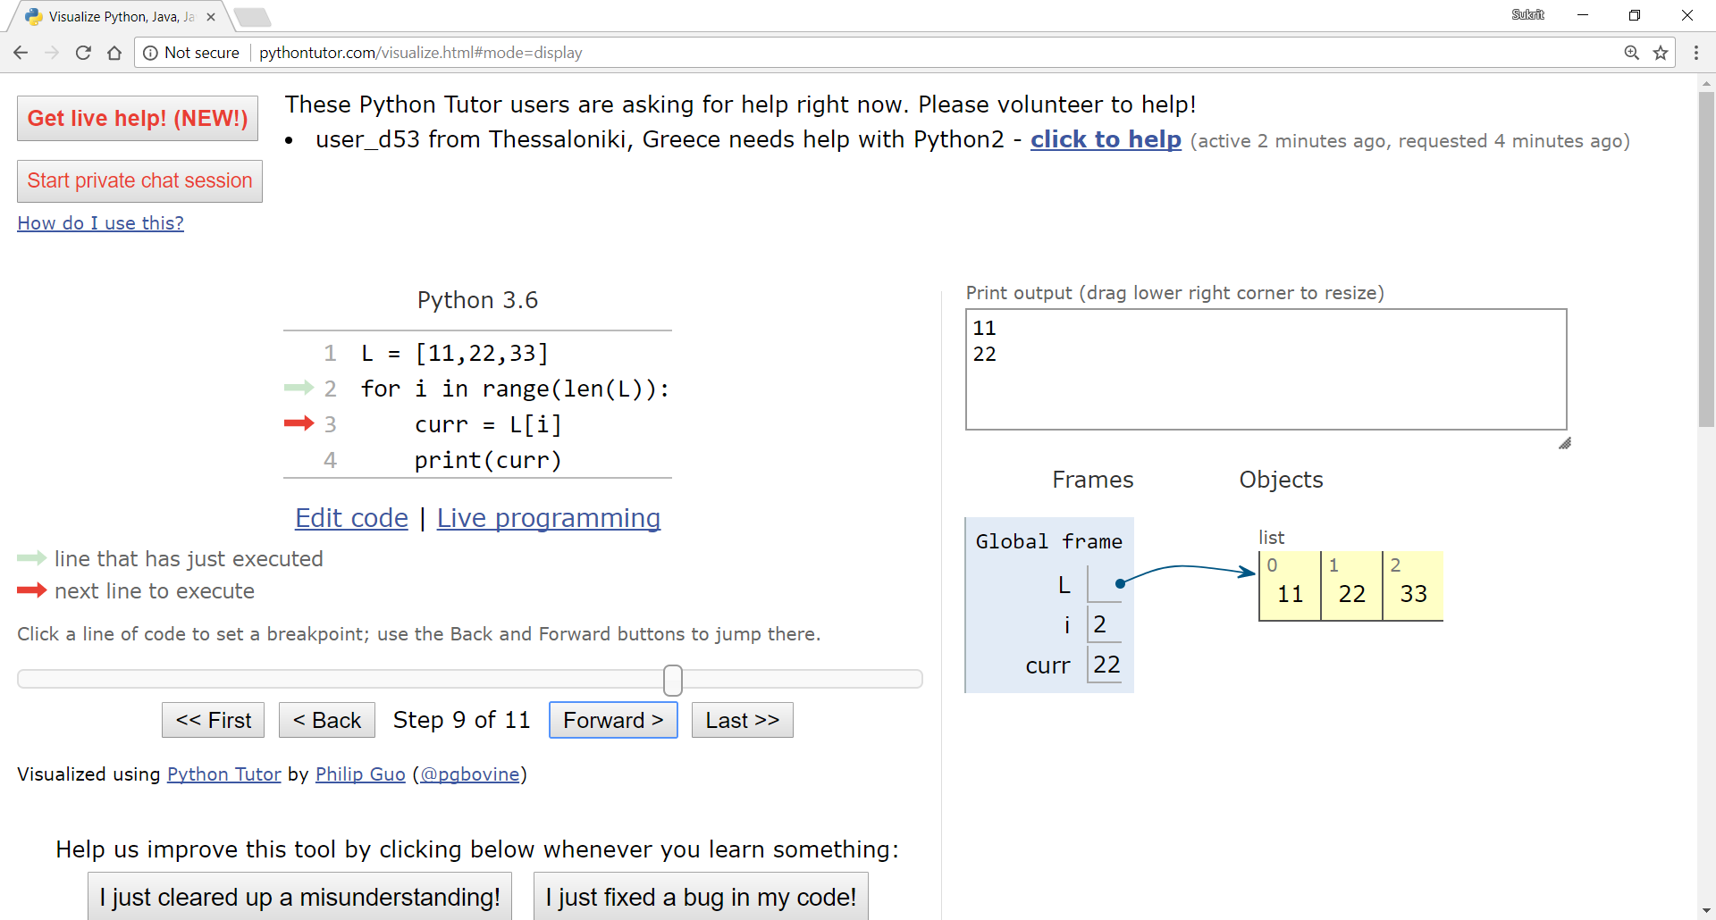
Visualizing iteration through lists

Slide 23

Visualizing iteration through lists

Slide 24

Visualizing iteration through lists

Slide 25
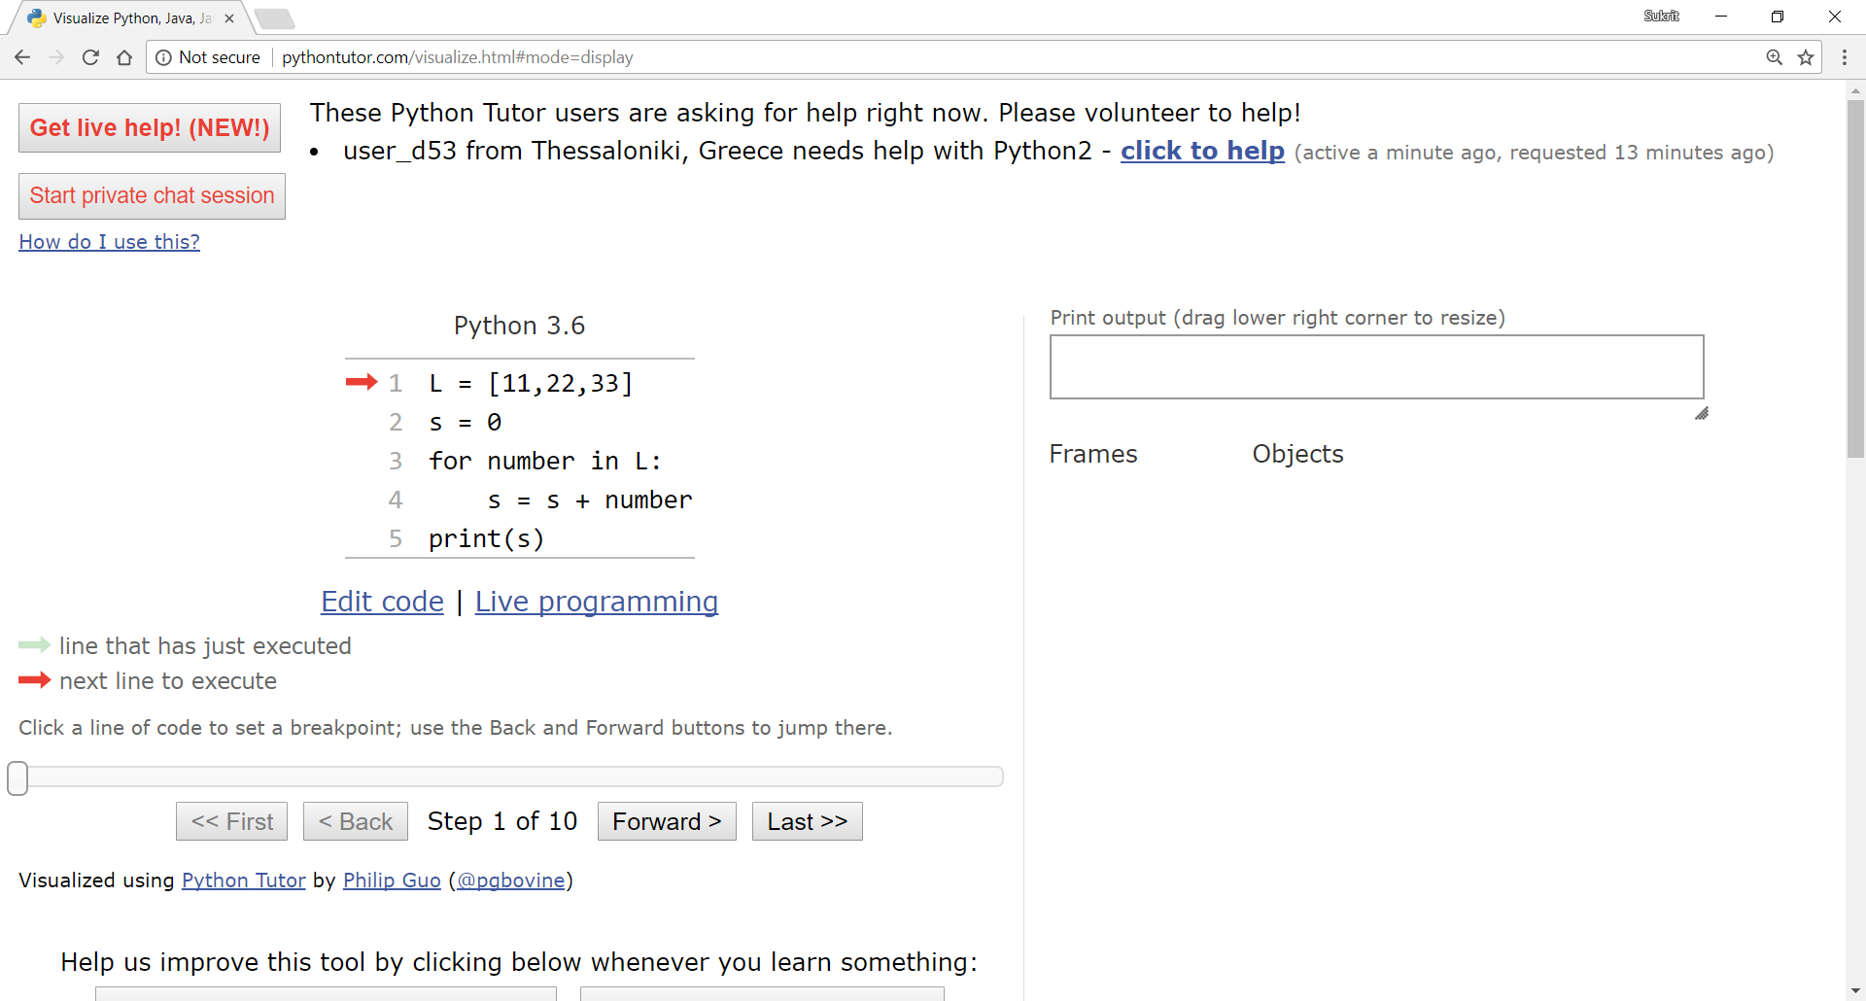
Visualizing iteration through lists

Slide 26
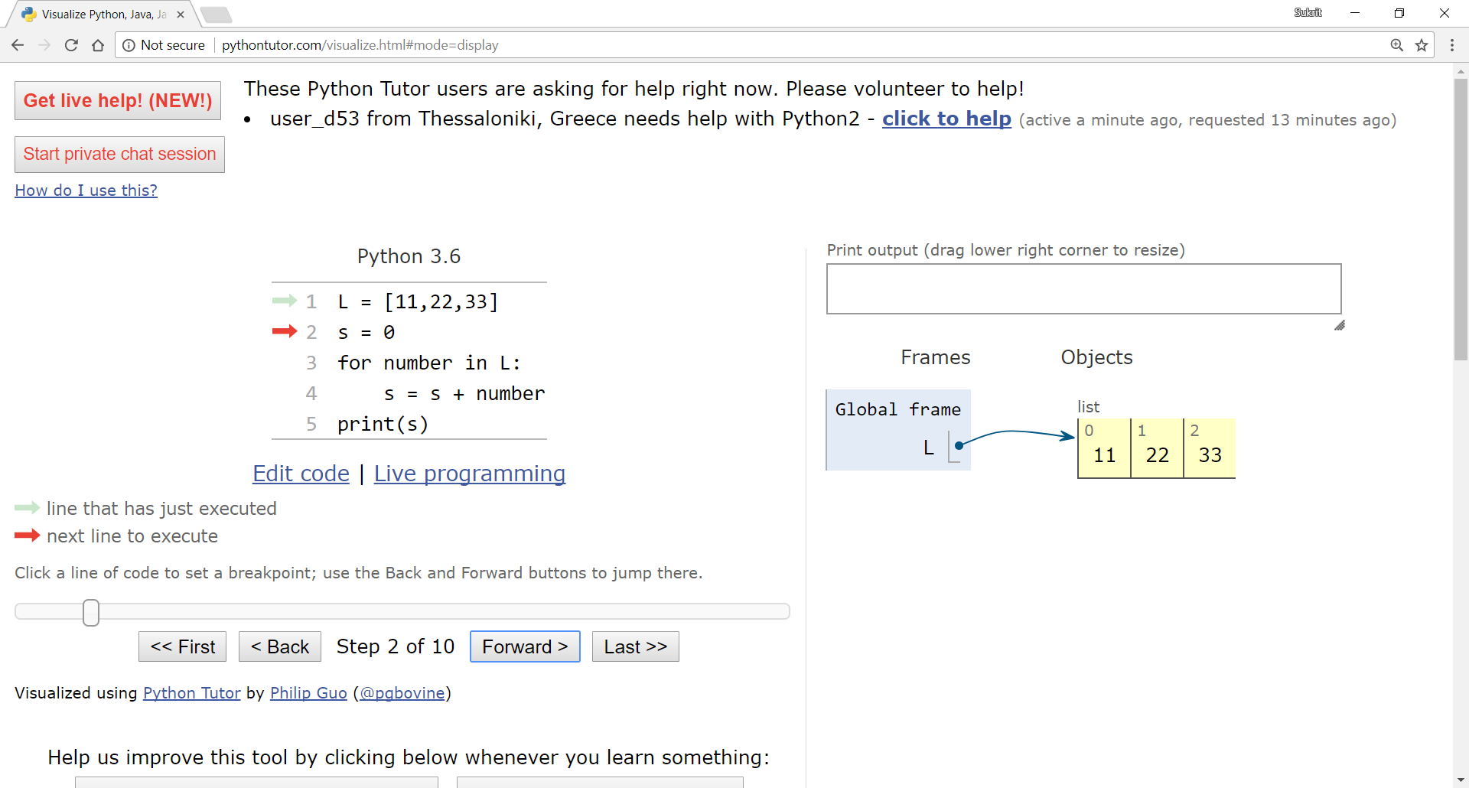
Visualizing iteration through lists

Slide 27
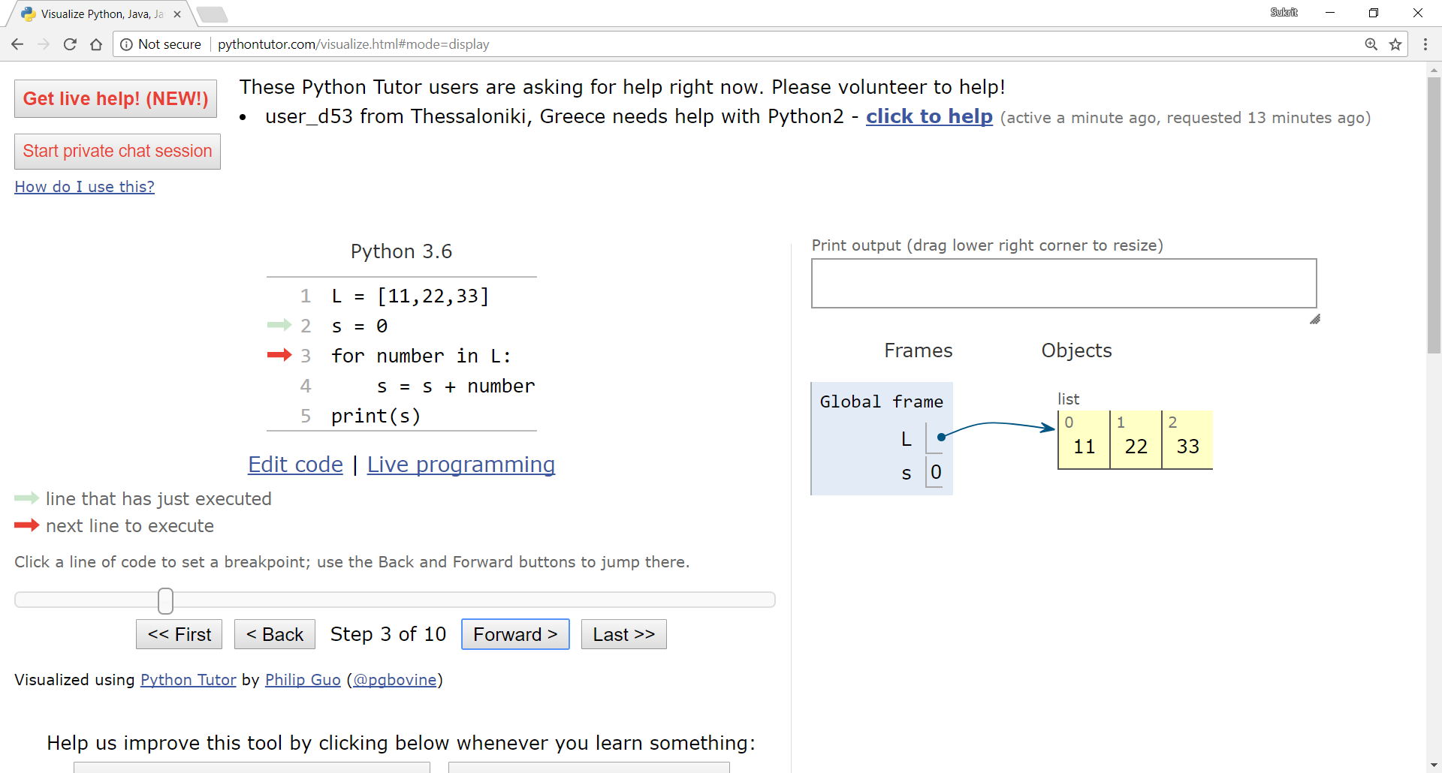
Visualizing iteration through lists

Slide 28
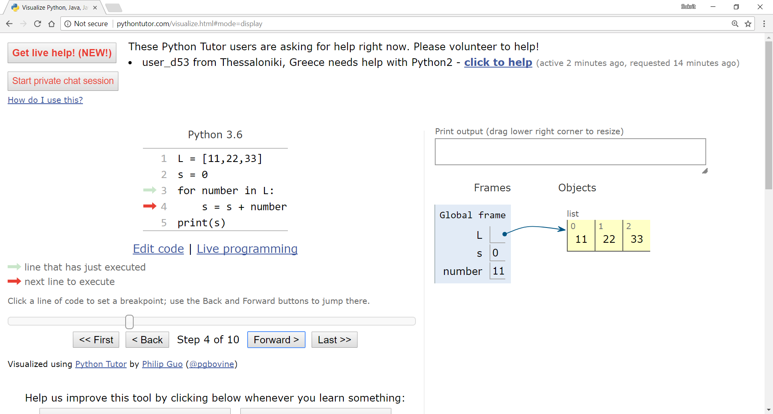
Visualizing iteration through lists

Slide 29

Visualizing iteration through lists

Slide 30

Visualizing iteration through lists

Slide 31

Visualizing iteration through lists

Slide 32
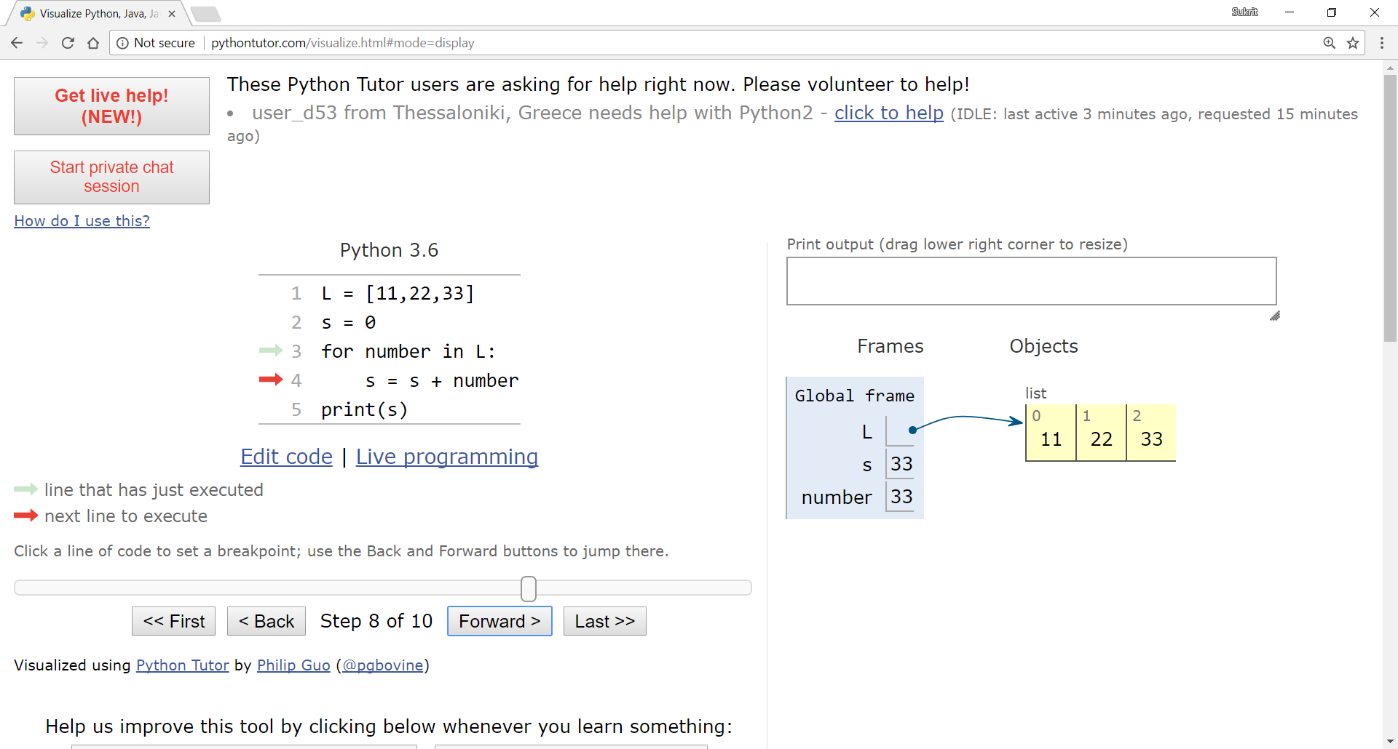
Visualizing iteration through lists

Slide 33

Visualizing iteration through lists

Slide 34
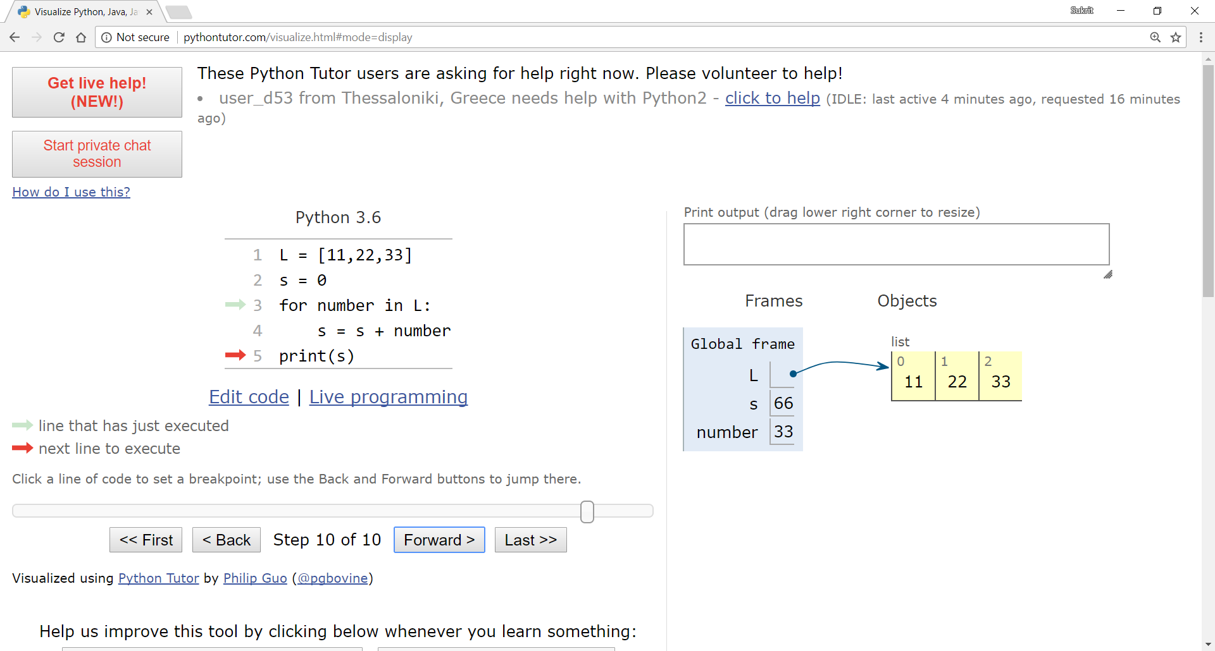
Visualizing iteration through lists

Slide 35
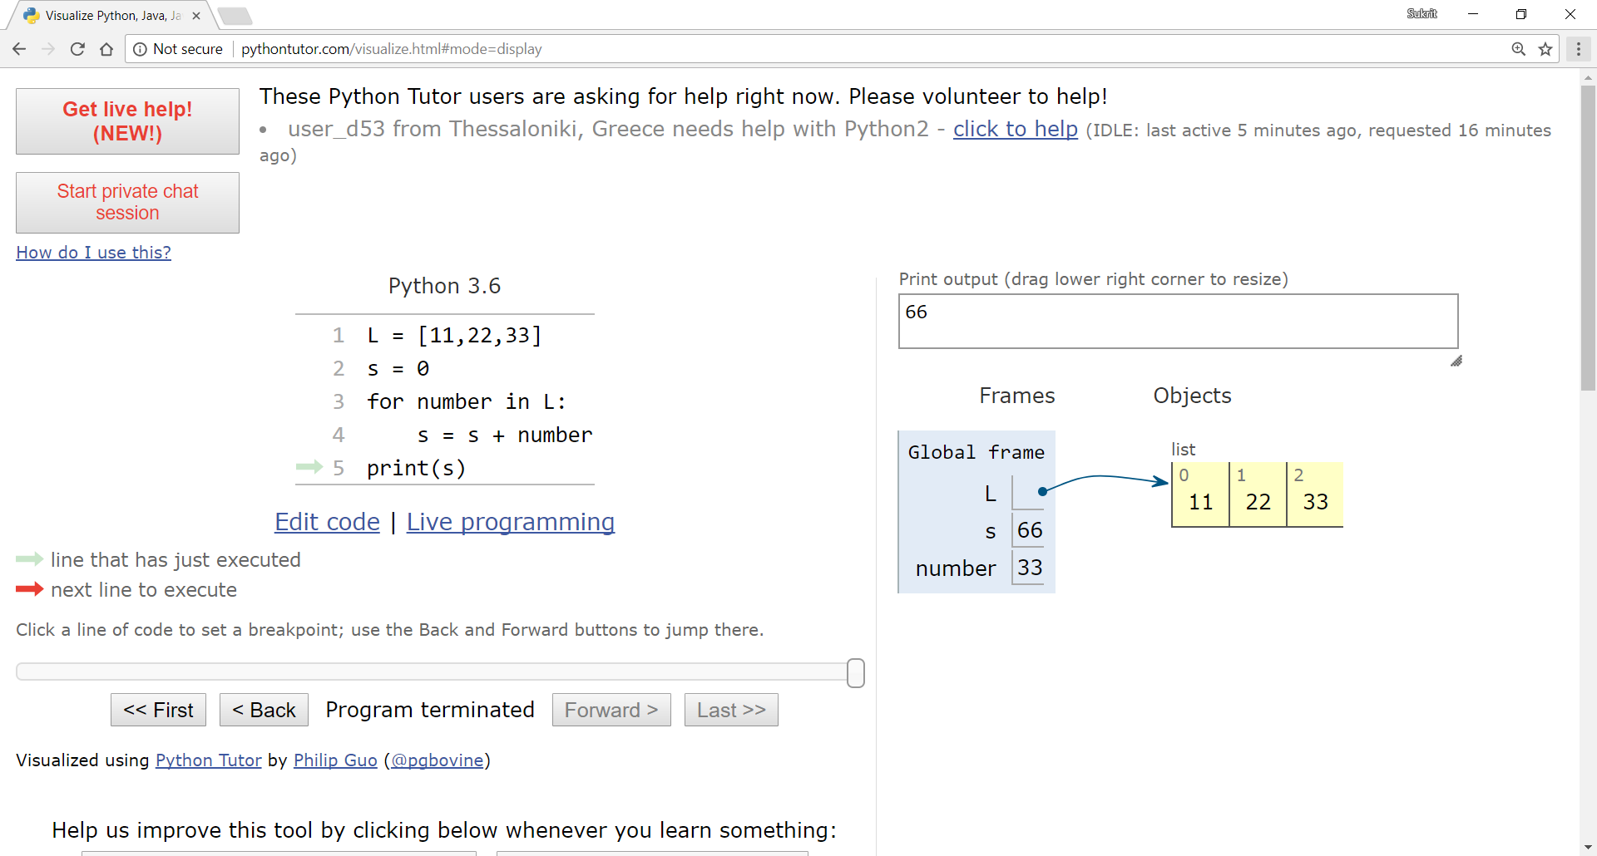
Visualizing iteration through lists

Slide 36
Odd and Even numbers of a list
l = [2, 6, 7, 9, 12, 13]
for i in range(len(l)):
if l[i] % 2 == 0:
print(l[i], "is even")
else:
print(l[i], "is odd")
2 is even
6 is even
7 is odd
9 is odd
12 is even
13 is odd

Slide 37
Odd and Even numbers of a list
l = [2, 6, 7, 9, 12, 13]
for number in l:
if number % 2 == 0:
print(number, "is even")
else:
print(number, "is odd")
2 is even
6 is even
7 is odd
9 is odd
12 is even
13 is odd

Slide 38
Sorting Algorithms
GOAL – efficiently sort a list of elements (typically numbers)
L = [3, 4, 1, 5, 6, 2] # unsorted
L = [1, 2, 3, 4, 5, 6] # sorted in ascending order
L = [6, 5, 4, 3, 2, 1] # sorted in descending order
There are many ways/algorithms for doing this, one simple way is by using an algorithm called bubble sort

Slide 39
Bubble sort
iterate through the list and compare consecutive pairs of elements
swap elements in pair such that smaller is first when sorting in ascending order and vice versa when sorting in descending order
when reach end of list, start over again
stop when no more swaps have been made in a single pass through the list
the algorithm needs one whole pass through the list without any swaps to know it is sorted, when it knows the list is sorted the process stops

Slide 40
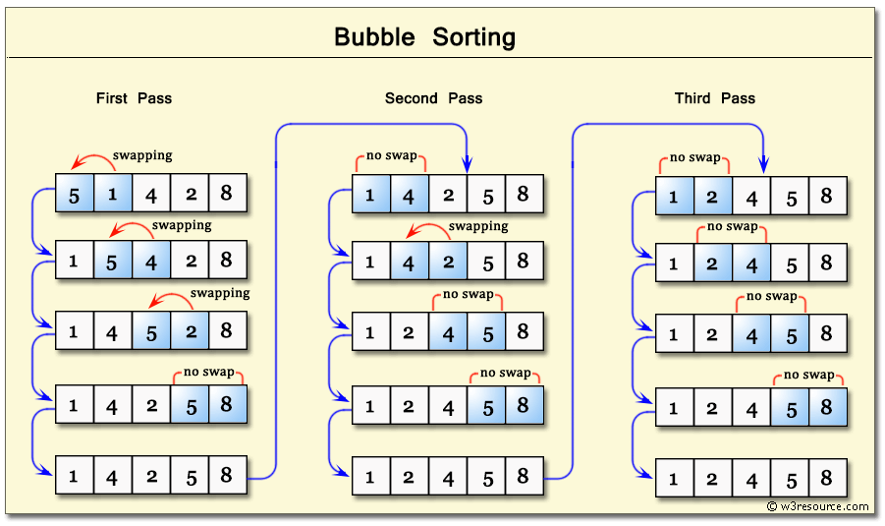
Bubble sort
notice that in the last pass no swaps were made, so the algorithm knows that the list has been sorted thus the process stops

Slide 41
Pseudocode
derived from the words pseudo and code
pseudocode is an informal high-level description of the operating principle of a computer program or an algorithm
is intended for human reading rather than machine reading
describes the algorithm in a more natural language
the purpose of using pseudocode is that it is easier for people (programmers) to understand than any conventional programming language code

Slide 42
Pseudocode
no standard for pseudocode syntax exists, as a program in pseudocode is not an executable program
however all primitive language constructs (conditionals, loops) should be explicitly begun and ended
proper indentation should be used to make code more understandable

Slide 43
Pseudocode example
algorithm add_two_numbers
input a,b
sum = a + b
output sum
end add_two_numbers

Slide 44
Pseudocode example
algorithm add_two_numbers
input a,b
sum = a + b
output sum
end add_two_numbers
start and end of algorithm/program must be specified

Slide 45
Pseudocode example
algorithm add_two_numbers
input a,b
sum = a + b
output sum
end add_two_numbers
input and output of the algorithm/program
start and end of algorithm/program must be specified

Slide 46
Pseudocode example
algorithm greatest_of_two
input a,b
if a > b then
max = a
else
max = b
end if
output max
end greatest_of_two
algorithm add_two_numbers
input a,b
sum = a + b
output sum
end add_two_numbers
start and end of algorithm/program must be specified
input and output of the algorithm/program

Slide 47
Pseudocode example
algorithm greatest_of_two
input a,b
if a > b then
max = a
else
max = b
end if
output max
end greatest_of_two
algorithm add_two_numbers
input a,b
sum = a + b
output sum
end addtwo_numbers
end of if statement should be specified as well
start and end of algorithm/program must be specified
input and output of the algorithm/program

Slide 48
Pseudocode example
algorithm greatest_of_three
input a,b,c
if a > b and a > c then
max = a
else if b > c and b > a then
max = b
else
max = c
end if
output max
end greatest_of_two
use and/or to chain multiple conditions
python comparison operators can be used to show comparison of values

Slide 49
Pseudocode example
algorithm factorial
input n
fact = 1
while n > 1
fact = fact * n
n = n - 1
end while
output fact
end factorial
python arithmetic operators can be used to show arithmetic operations
end of while loop must be specified as well

Slide 50
Pseudocode example
algorithm max_list
input list
max_element = list[0]
for i = 1 to list.count - 1
if list[i] > max_element then
max_element = list[i]
end if
end for
output max_element
end max_list
end of for loop must be specified

Slide 51
Pseudocode example
list.count denotes the number of elements here
similarly list.length or len(list) can be used
remember that there are no standards
as long as it’s clear what’s going on, it’s fine
algorithm max_list
input list
max_element = list[0]
for i = 1 to list.count - 1
if list[i] > max_element then
max_element = list[i]
end if
end for
output max_element
end max_list
end of for loop must be specified

Slide 52
End of Lecture 5

Slide 53
Thank you ! Any questions ?

